Slide 1


Session on Industry standards - HL7, DICOM
Jaswanth Kumar V
Program Manager

Slide 2
What is HL7

Slide 3
Introduction to Medical Standards
Standards are the set of guidelines.
Medical Standards is a set of guidelines defied for medical field.
Some Medical standards are
HL7
HL7 V3
DICOM
FHIR

Slide 4
Why HL7
Hospitals and other healthcare provider organizations typically have many different computer systems used for everything.
Patient Admit
Doctor Appointment
Doctor observation/Prescription
Billing records to patient tracking
Insurance
Lab

Slide 5
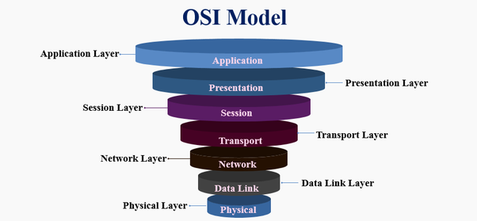
What is HL7
Health Level Seven or HL7
Set of international standards for transfer of clinical and administrative data between software applications used by various healthcare providers
These standards focus on the application layer, which is "layer 7" in the OSI model.

Slide 6
About HL7 Org
HL7.org
About HL7 | Founded in 1987, Health Level Seven International (HL7) is a not-for-profit, ANSI-accredited standards developing organization dedicated to providing a comprehensive framework and related standards for the exchange, integration, sharing, and retrieval of electronic health information that supports clinical practice and the management, delivery and evaluation of health services.
Mission | HL7 provides standards for interoperability that improve care delivery, optimize workflow, reduce ambiguity and enhance knowledge transfer among all of our stakeholders, including healthcare providers, government agencies, the vendor community, fellow SDOs and patients. In all of our processes we exhibit timeliness, scientific rigor and technical expertise without compromising transparency, accountability, practicality, or our willingness to put the needs of our stakeholders first.
http://www.hl7.org/
Notes:
Many healthcare facilities have installed healthcare information technology; however these systems have been developed with proprietary vendor specifications. In recent years, there has been the need to share patient data. HL7 is a standards developing organization, as well as a comprehensive framework and related standards for the exchange of electronic health information. The mission of HL7 is to provide interoperability standards that improve care delivery, optimize workflow, reduce ambiguity and enhance knowledge transfer.

Slide 7


The HL7 standards
The HL7 standards are produced by Health Level Seven International
Adopted by other standards issuing bodies such as
American National Standards Institute
International Organization for Standardization

Slide 8
Some Common terms used in medical standards
HIS - Hospital Information System
EMR- Electronic medical records
LIS - Laboratory information system
RIS - Radiological Information System
ASTM – American society for testing & material
Modality – MRI, CT, X-Ray

Slide 9
Role of HL7 Messaging
To improve the electronic exchange of demographic, and immunization records to State IIS (registries) from eligible providers and hospitals
To improve the ability of eligible hospital laboratories to send reportable data to public health agencies
To improve the electronic exchange of relevant syndromic surveillance data between healthcare providers and public health agencies
Notes:
HL7 was chosen as the default messaging standard. These are the roles of HL7 messaging for immunization, lab reporting, and surveillance respectively.

Slide 10
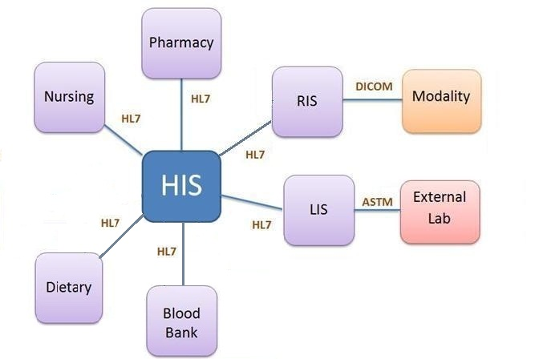
General HL7 workflow

Slide 11
Definitions
Data Type – a restriction on the contents of a field
Field – a string of characters defined by one of the HL7 data types
Field Separator – this character separates two adjacent data fields within an HL7 segment
HL7 – an application protocol for electronic data exchange in healthcare environments
Message – the atomic unit of data transferred between systems, consisting of segments in a defined sequence
The HL7 Version 2.5 Standard Copyright©2003 by Health Level Seven, Inc.
Notes:
The following two slides provide a few definitions. Later in this presentation, examples of data and message types will be displayed. In addition, a sample message will show fields and segments.
A key point to mention would be messages are an atomic unit of data meaning that messages are transmitted as one complete element. Partial messages are not sent or received.

Slide 12
Definitions
Message Type – the specific purpose
Order – a request for material or service
Observation – performance of the service including result data
Segment – a logical grouping of data fields identified by three letter identification (MSH, PID, OBX, …)
Trigger Event – a real world event that initiates an exchange of messages. There is a one to many relationship between message type and trigger event.
The HL7 Version 2.5 Standard Copyright©2003 by Health Level Seven, Inc.
Notes:
The key point on this slide is the trigger event. For example, when someone is brought into an emergency department and the decision is made to admit this person into the hospital, this real world event would initiate an electronic message being sent to admit this patient.

Slide 13
Rules
Message Header Segment (MSH) is required and always first
There may be more than one type of segment and can be nested
[ ] – Optional segment
{ } – Repeating segment
Optionality
R – Required | RE – Required but may be empty
O – Optional | C – Conditional depending on trigger event or some other field
X – not used with this trigger event | B – Backwards compatible with previous HL7 versions
The HL7 Version 2.5 Standard Copyright©2003 by Health Level Seven, Inc.
Notes:
The Message Header Segment or MSH segment is required for all messages and defines the intent, source, destination, and specific attributes of the message, like delimiters and version number.
Messaging or Implementation Guides establish an agreement on what messages will be sent and received. One of the parameters that this document establishes is the optionality of segments and fields.

Slide 14
Rules
Recommended message delimiters (field 2 of MSH)
There is a one to many relationship between message type and trigger event.
ADT – (A01, A02, A03, A04, A05, …)
Trigger events are specific to message type
Delimiter | Value
Field Separator | |
Component Separator | ^
Subcomponent Separator | &
Repetition Separator | ~
Escape Character | \
The HL7 Version 2.5 Standard Copyright©2003 by Health Level Seven, Inc.
Notes:
Although you can specify different delimiter for segments and fields, it is highly recommended that you use the default value. Using an inappropriate value can have a negative effect on the content of a segment or an entire message.
In addition, a message type like Admission, Discharge and Transfer (ADT) messages can have many trigger events, for example A01 – Admit, A02 – Transfer, A03 – Discharge, A04 – Register, A05 – Pre-admit, etc.

Slide 15
Rules
Acknowledgement messages are sent to indicate if receiving application was able to:
Parse message
Decode message
Assume responsibility for the message
Process message contents
Successfully commit to storage
The HL7 Version 2.5 Standard Copyright©2003 by Health Level Seven, Inc.
Notes:
Acknowledgement messages confirm the message is received and that it is in the agreed upon format. Otherwise, the receiving application will return an error message which will be sent to the sending application. Depending on the type of acknowledgement, the receiving application will do some or all of these functions.

Slide 16
Rules
Null versus empty
Null is used when data is present but without a value “ “
The field is left blank when there is no data
Example: PID | | |54321|9876-3|Doe^John|”“|…
Receiving systems:
Will ignore the data within segments, fields, etc that are present but not expected
Will treat expected segments that are not present as a segment with all fields not present
Will treat expected fields and components that are not included as not present
The HL7 Version 2.5 Standard Copyright©2003 by Health Level Seven, Inc.
Notes:
Some fields are left blank when there is no data sent or expected. For fields where data is expected but the sender does not have a value, null is used.
As mentioned on the previous slide, applications confirm receipt. This happens through rules which are established to clarify how the receiving system will handle messages with expected and unexpected content.

Slide 17
Common Message Types
Type | Abbreviation
Admission, Discharge, Transfer | ADT
General Clinical Order Message | OMG
Imaging Order | OMI
Laboratory Order Message | OML
Pharmacy/treatment Order Message | OMP
General Order Message | ORM
Unsolicited Observation/Result | ORU
Unsolicited Vaccination Record Update | VXU

Slide 18
Common Data Types
Type | Abbreviation | Definition
Coded Element | CE | Used to transmit codes and associated text
Composite Quality with units | CQ | Specifies the numeric quantity or amount, and the units in which the quantity is expressed
Extended Address | XAD | Specifies the address of a person, place, or organization plus associated information
Extended Person Name | XPN | Specifies the complete name of a person plus associated information
Numeric | NM | A number (integer)
String Data | ST | Any displayable/printable ACSII characters intended for strings less than 200 characters
Text Data | TX | Longer string data intended for display purposes
Time Stamp | TS | Specifies a point in time including time zone
The HL7 Version 2.5 Standard Copyright©2003 by Health Level Seven, Inc.
Notes:
There are also dozens of data types. This list identifies more common data types. The coded element data type is used for capturing data that represent coding systems like LOINC (used for laboratory and other clinical observations) and SNOMED (which is a list of comprehensive clinical terminology).

Slide 19
Some Message Types
ADT message - The Admission, Discharge, Transfer (ADT) Message
ADT-A01 – Admit/visit notification
ADT-A02 – patient transfer
ADT-A03 – patient discharge
ADT-A04 – patient registration
ADT-A11 – cancel patient admit
ORM Message - Pharmacy/treatment order message
ORU Message - Unsolicited transmission of an observation message
ACK Message - General acknowledgment message

Slide 20
Sample HL7 Message
ADT^A01:Admit message
MSH|^~\&|HIS|HIS 1|||201305171724||ADT^A01^ADT_A01|26606|P|2.5
EVN||201305171724
PID|||17||Reddy^Sumanth^^^Mr||19900919|M|||&3rd Cross&903/S^Hebbal 2nd Stage^Mysore^Karnataka^570017||^^PH^^^^2457623|^^CP^^^^9994456413|Kannada|M||||||||||Indian
NK1|1234||SPO|||||||||||||||||||||||||||^Menaka|^^CP^^^^8776452142
PV1||I||E|||||||||||||^^Ashwin^^^Dr
Message | Segment | Element | Component | Sub component
ADT^A01 | MSH,EVN,PID,NK1, PV1 | | | ^ | &

Slide 21
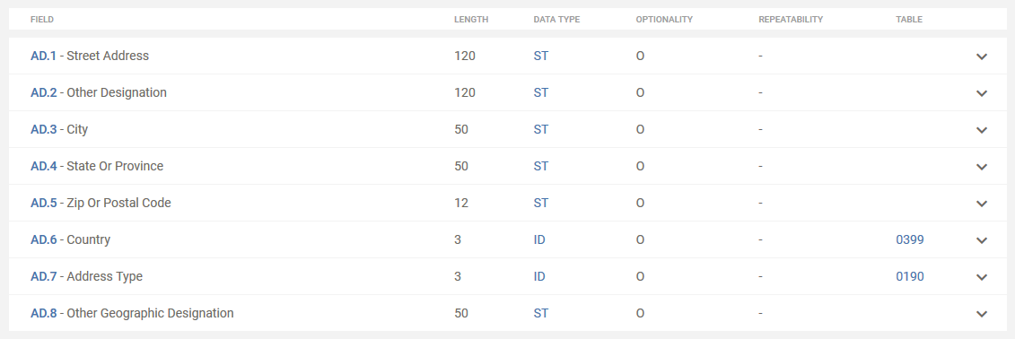
HL7 Data types
AD- Address:
DTM – Date/Time:

Slide 22
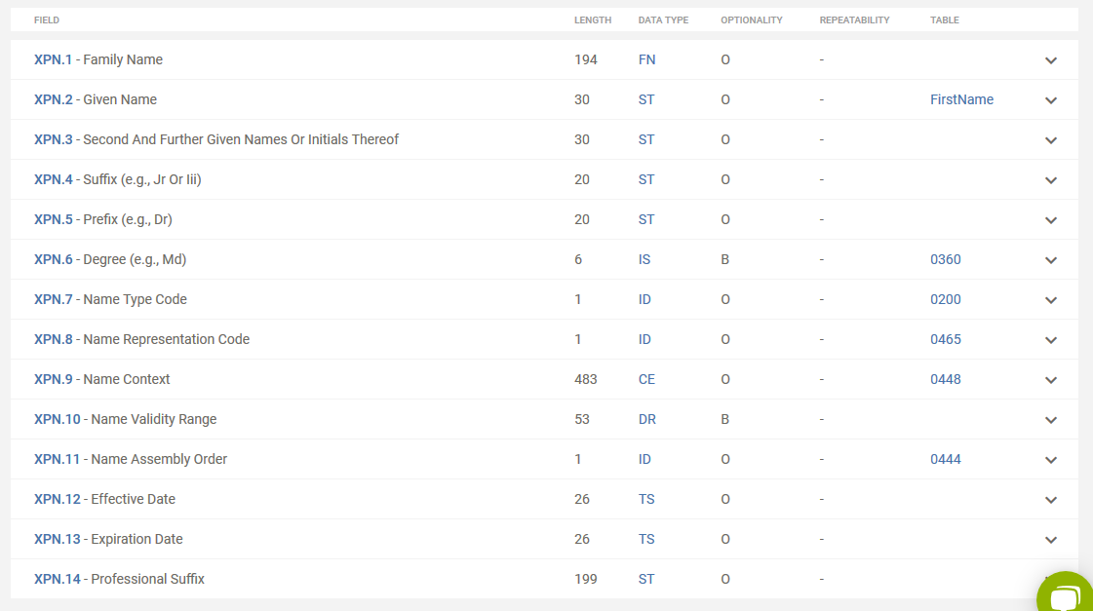
Patient Name

Slide 23
Patient Admittance Message from ADT
ADT^A01:Admit message
MSH|^~\&|HIS|HIS 1|||201305171724||ADT^A01^ADT_A01|26606|P|2.5Patient Admittance Message from ADT Module to RIS and LIS Modules
EVN||201305171724
PID|||17||Reddy^Sumanth^^^Mr||19900919|M|||&3rd Cross&903/S^Hebbal 2nd Stage^Mysore^Karnataka^570017||^^PH^^^^2457623|^^CP^^^^9994456413|Kannada|M||||||||||Indian
NK1|1234||SPO|||||||||||||||||||||||||||^Menaka|^^CP^^^^8776452142
PV1||I||E|||||||||||||^^Ashwin^^^Dr
Description: The Married Male Patient with name Mr. Sumanth Reddy with Date of Birth 19th September 1990 residing at 903/S, 3rd cross, Hebbal 2nd stage Mysore, Karnataka 570017 with phone no.2457623 and cell no. 9994456413 with Indian citizenship and Kannada as Primary language his Spouse Menaka with cell no. 8776452142 as emergency contact has been admitted as Inpatient – Emergency by Dr.Ashwin at 17:24 on 17th May 2013

Slide 24
Order Message from Order-Report
ORM^O01:General Order Message for Radiology
MSH|^~\&|ORD-RPT|ORD -RPT1|RIS|RIS1|201305171742||ORM^O01^ORM_O01|18146|P|2.5
PID|||13||Reddy^Sumanth^^^Mr||19900919|M
PV1||I||E||||^^E.Adarsh^^^Dr||PSG|||||||^^Ashwin^^^Dr
ORC|NW
OBR||||1766||201305171745||||||||||^^E.Adarsh^^^Dr||||||||RX||||||CART|^Weakness|||||||||||R
Description: A Male Patient Mr.Sumanth Reddy born on 19th Sep 1990 admitted as Inpatient - Emergency by Dr.Ashwin . Dr.E.Adarsh palces a New Order for this patient with Radiograph service with Escort Required and Transport type with Patient travels on cart who has Weakness as reason for test on 17th May 2013 at 17:45

Slide 25
Observation Message from Radiology
ORU^R01:Observation message for general order test
MSH|^~\&|RIS|RIS 1|ORD-RPT|ORD-RPT1|20130517174716||ORU^R01^ORU_R01|18516|P|2.5
PID|||17|| Reddy^Sumanth^^^Mr ||19900919|M
PV1||I||E||||^^Dr.E.Adarsh^^^Dr||PSG|||||||^^Ashwin^^^Dr
ORC|NW
OBR||||4602||201302141745||||||||||^^Dr.E.Adarsh^^^Dr||||||||BLB||||||CART||||||||||||R
NTE|1||Below Normal Values
OBX||ED|||Adobe^text^pdf^Base64^VGHpcy…………………….|||L|||F|||20130517|||||20130517
Description: A Male Patient Mr.Sumanth Reddy born on 19th Sep 1990 admitted as Inpatient - Emergency by Dr.Ashwin . Dr.E.Adarsh palces a New Order for this patient with BloodBank service with Escort Required and Transport type with Patient travels on cart who has Weakness as reason for test on 17th May 2013 at 17:45. In reply to this order, Encapsulated Data is sent based on Final result status and the values are Below normal level commenting Patient’s Observed values are below normal and observation, analysis done on 17th May 2013.

Slide 26
Detail analysis
Detail analysis of ADT/ACK - Admit/Visit Notification (Event A01) message structure.

Slide 27
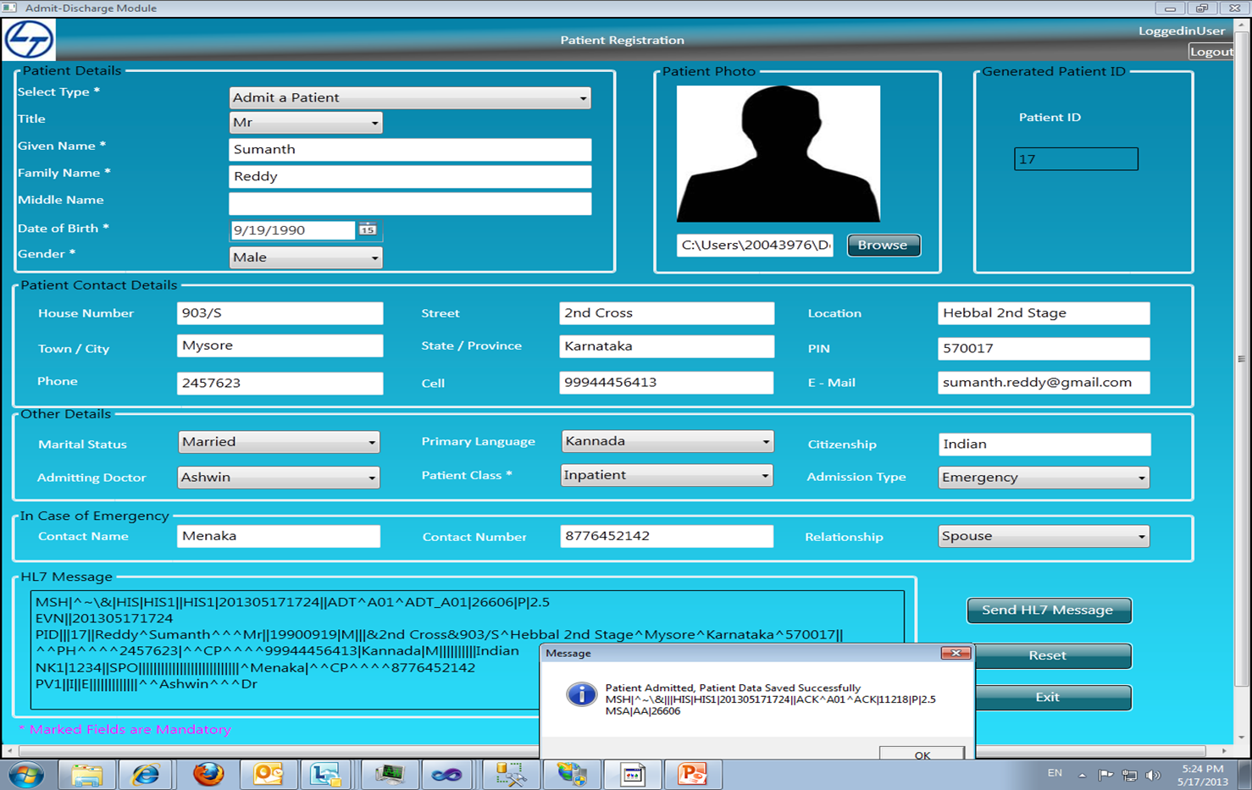
ADT Mock up screen

Slide 28
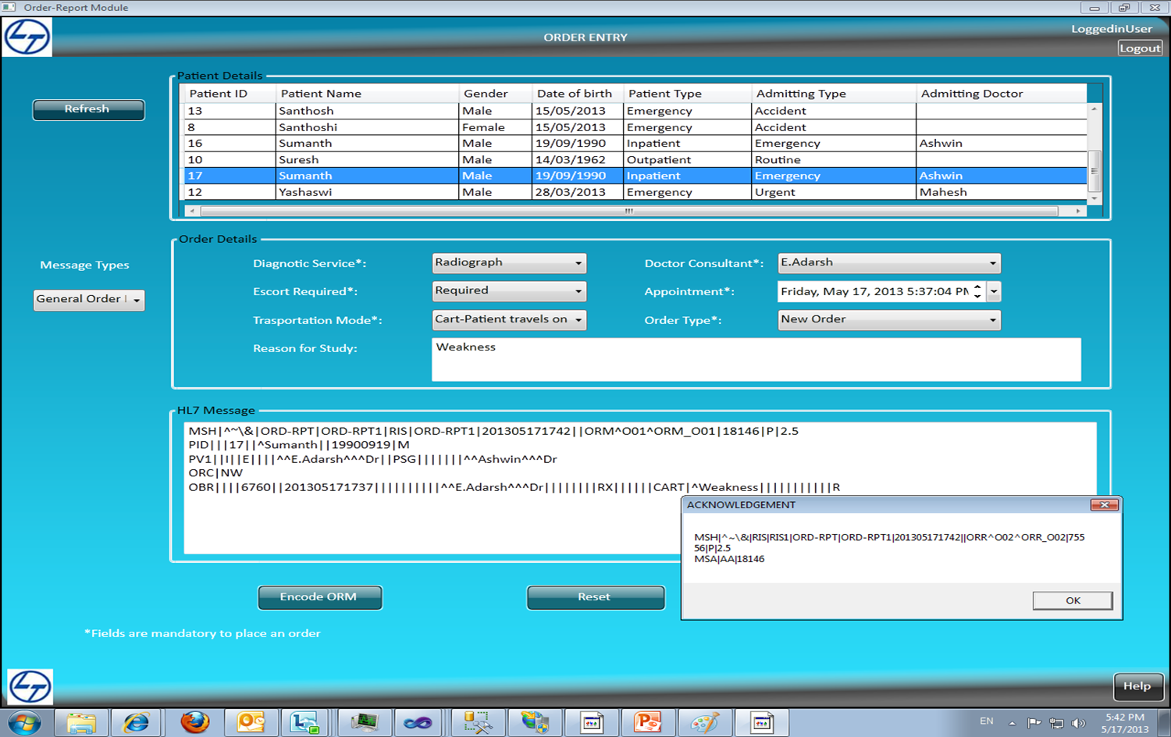
ORM Mock up screen

Slide 29
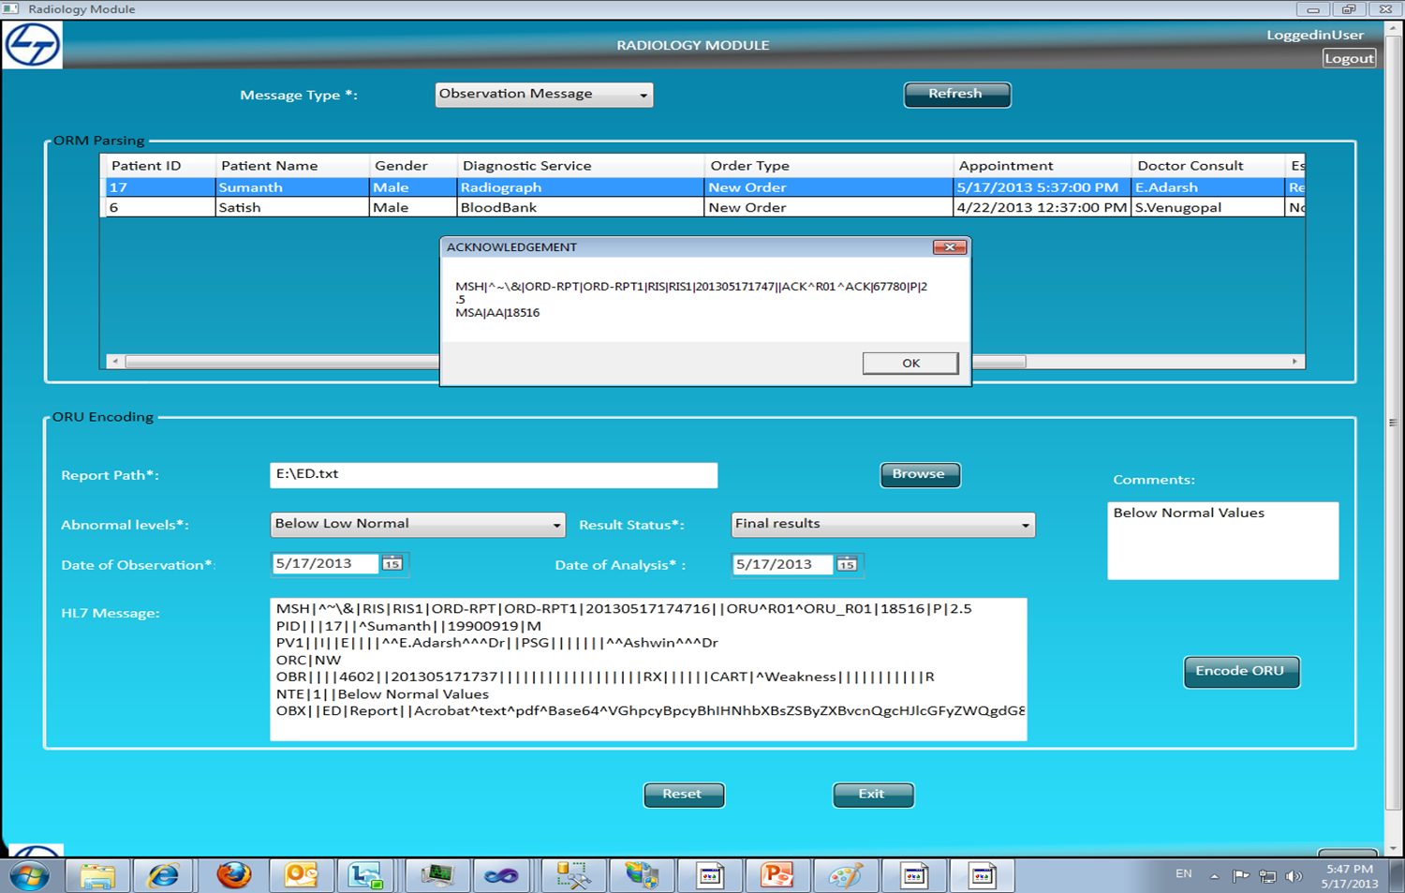
ORU Mock up screen

Slide 30
HL7 Libraries
Nhapi
HAPI
Python-hl7

Slide 31





Clients we work for

Slide 32

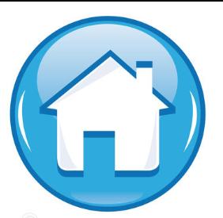
Thank You !

